Slide 1

Art Gallery – Project 2 Midterm Presentation
Vanessa Gutierrez • Edward Figueroa • Charles Marsala • Kyle Fillhart

Slide 2

Vanessa Gutierrez – Team Lead & Backend/API
Team Leadership
DevOps & Infrastructure
API Integration
Oversaw project execution, provided direction, and resolved team conflicts or technical roadblocks to maintain velocity.
Set up the essential development environment, including GitHub organization, repository structure, and continuous integration/continuous deployment (CI/CD) pipelines.
Integrated and tested the FGCU Dataverse API to ensure robust data retrieval for the prototype.
Key Challenge: Dataverse Setup
Initial attempts to set up a local Dataverse instance following the official installation guide were overly time-consuming. We discovered more efficient methods for direct database access and testing.

Slide 3
Edward Figueroa - Backend
API Identification & Testing
Live Data Analysis
Found the correct art collection (art alias) and confirmed API endpoints (Search, Native, Access) needed to fetch data.
Examined the JSON structure from API calls to understand available metadata.
Schema Discovery
Key Documentation
Found the existing "art" metadata block FGCU uses.
Updated Architecture.md and README.md; created API_GUIDE.md with examples for the frontend team.

Slide 4
Charles Marsala - Frontend
Frontend Development
UX Design Implementation
Built the user interface using React with TypeScript, creating a responsive gallery experience that works seamlessly from mobile to desktop.
Designed a MoMA-style grid layout with readable typography, large thumbnails, and clear metadata presentation for optimal user experience.
API Integration
Quality Assurance
Connected the React frontend to live FGCU Dataverse API data, implementing search functionality with keyword filters and paginated results.
Ensured responsive design, fast image loading, and basic accessibility features including semantic headings and alt text.
Key Challenge: Figma to Code Translation
Converting the initial Figma prototype designs into a fully functional React application while maintaining design fidelity and ensuring responsive behavior across all device sizes.

Slide 5
Kyle Fillhart - Frontend
Frontend Development
UI/UX Enhancements
Added download buttons to each artwork in both the gallery and detail views for user accessibility.
Ensured that all interactive elements provide clear visual feedback and accessibility compliance.
Developed an admin upload page to allow new artwork submissions with metadata fields (Title, Artist, Year, Medium, Description).
Ensured zero delay when using the admin upload feature.
Integrated new functionality within the existing React/Tailwind framework, maintaining project consistency and responsiveness.
Mobile Experience
Usage Quality
Implemented a toggle button that switches between mobile and desktop layouts for testing and demonstration.
Instant image downloads
Conducted interface checks for performance and responsiveness on multiple devices
Optimized the gallery grid and artwork detail views for smaller screens.
Verified responsive design using Tailwind utilities to maintain readability and performance across devices.
On top of the regular citation button, there is another one that automatically formats a MLA citation for the desired image.
Key Challenge:
Translating the multi-layout (mobile and desktop) design from Figma into responsive React components while maintaining consistent alignment and interactive behavior across all device sizes.

Slide 6
APIs Used for Data Retrieval
Goal: Connect our React application to the FGCU Dataverse server (dataverse.fgcu.edu) to fetch artwork data.
Fetching Initial Content List
Fetching Artwork Details
Fetching Images/Downloads
API Endpoint: /api/dataverses/art/contents
API Endpoint: /api/datasets/{item.id}
API Endpoint: /api/access/datafile/{file_id}
Purpose: Gets detailed metadata for a single dataset (artwork) using its database ID.
Purpose: Retrieves a list of items (datasets) directly within FGCU's art collection.
Purpose: Gets the actual image file content using the specific File ID obtained from the artwork details (API #2).
Application Use: Called for each item found in the initial list to get full details (title, artist, medium, file info, etc.) for display.
Application Use: Called when the gallery page loads to get the initial list of artworks.
Application Use: Used to construct the URL for displaying images and for the download button.
Authentication: Passes API key in the URL (?key=...).
Authentication: Passes API key in the URL (?key=...).
Authentication: Not needed in the URL for public files.

Slide 7
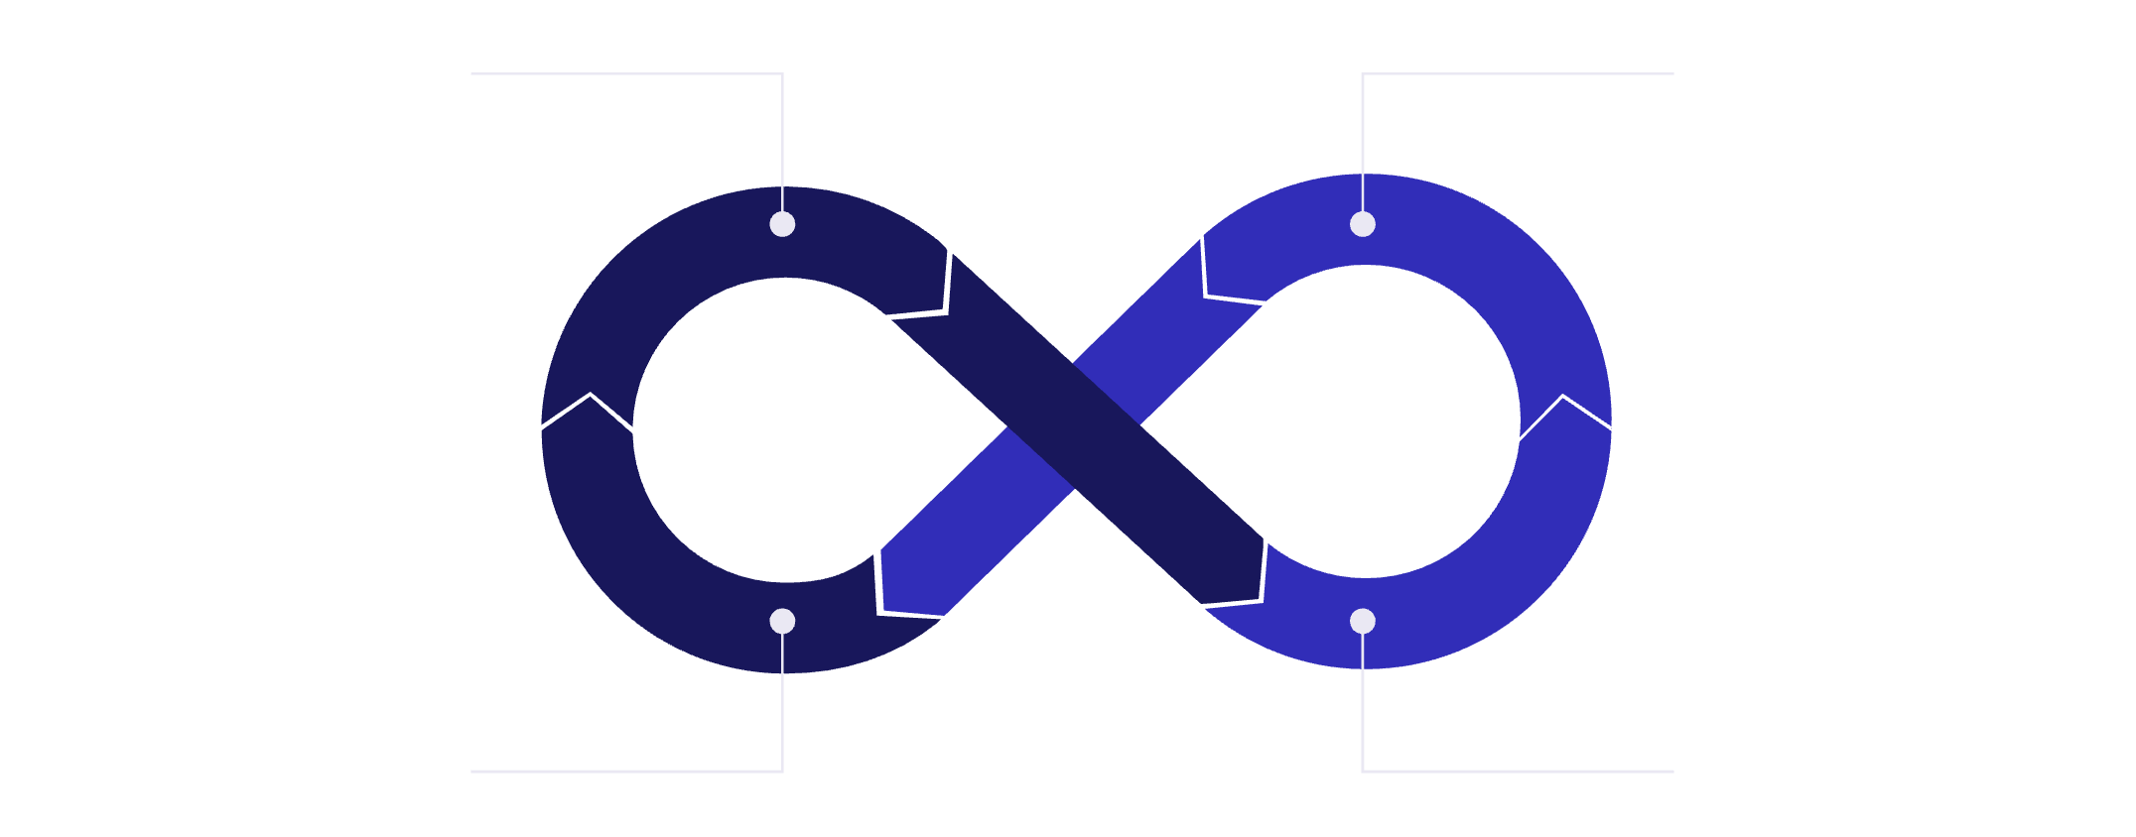

Our Software Development Model
Embracing the Agile Methodology
We adopted an Agile approach, which provided the flexibility needed to handle unexpected issues, such as the initial Dataverse setup challenge, while maintaining a clear, iterative progression toward our goal.
Plan & Design
Develop & Test
Continuous Cycle
Review & Feedback
Semester-Long Schedule
Established high-level goals and milestones for the entire project duration.
Weekly Sprints
Divided the overall schedule into manageable weekly tasks to ensure steady progress and accountability.
Trello Management
Utilized Trello as our project management tool for task assignment, status tracking, and maintaining transparency across the team.

Slide 8

Our Prototype: Functionality & Technology
Technology Stack
Current Features
Our prototype was developed with modern, industry-standard tools for maximum performance and future scalability:
Advanced Search Filters
Frontend: React with TypeScript for robust, type-safe development.
Users can precisely search and filter by year, artist, genre, and medium.
Backend: FGCU Dataverse instance.
Styling: Tailwind CSS for rapid, utility-first UI design.
Metadata View
Prototyping Tool: Figma Make used for initial wireframing and interactive mockups.
Detailed citation and comprehensive art metadata are accessible for academic use.
Optimized Loading
Implemented pagination ensures that results load quickly, enhancing user experience for large collections.

Slide 9
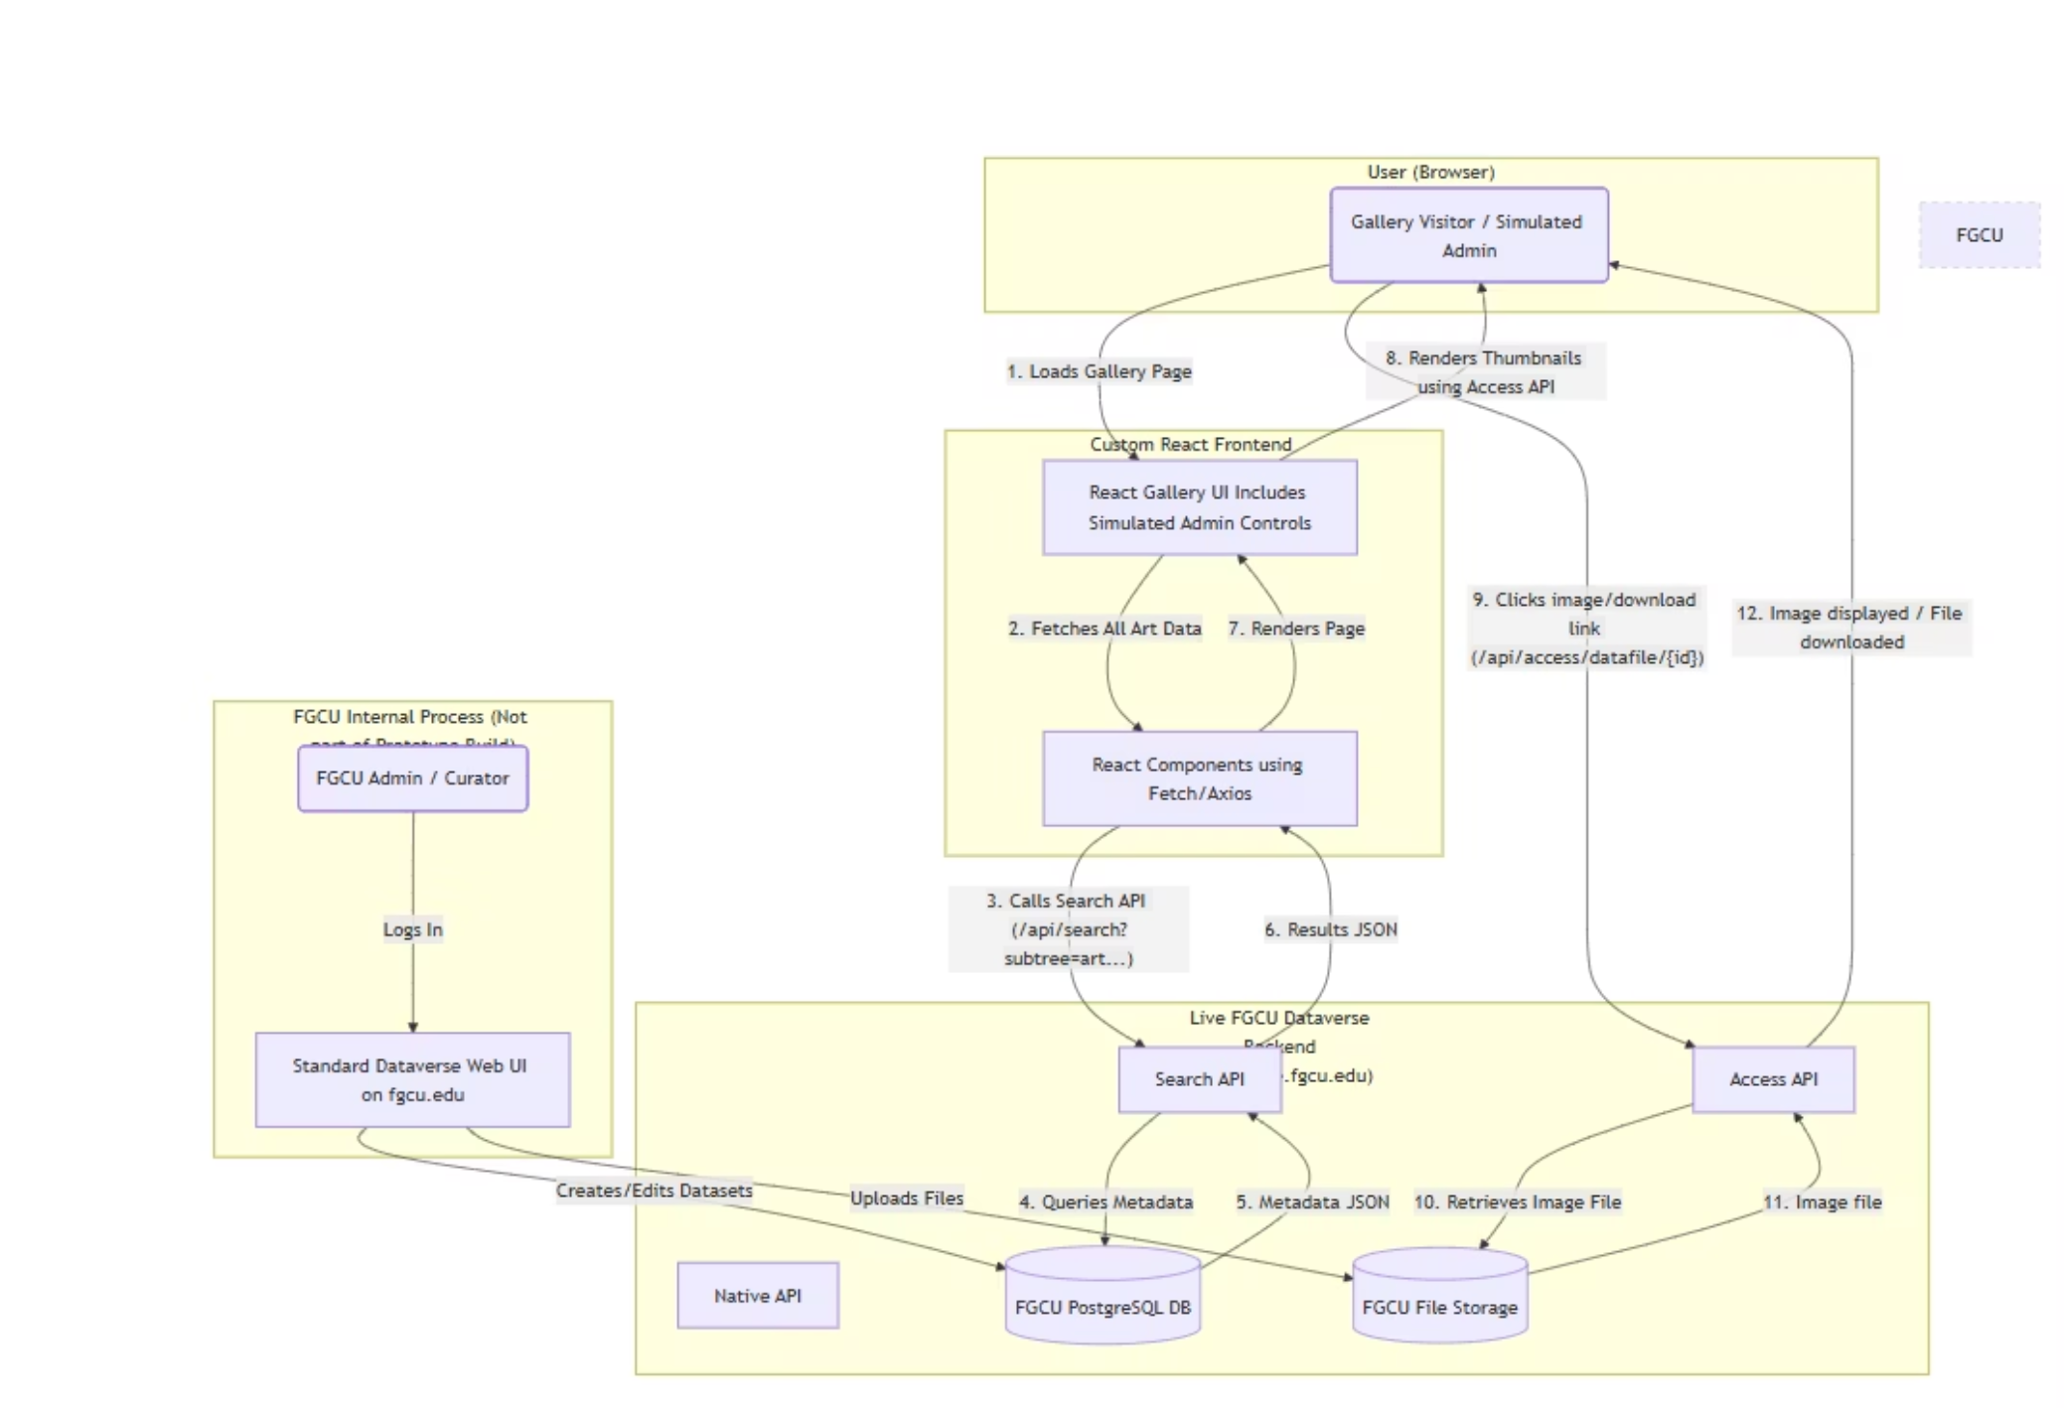

Our System Architecture
The integration point is crucial: the prototype communicates directly with the FGCU Dataverse's base URL, using an API token and specifying the subtree where the library stores its artwork collections.

Slide 10
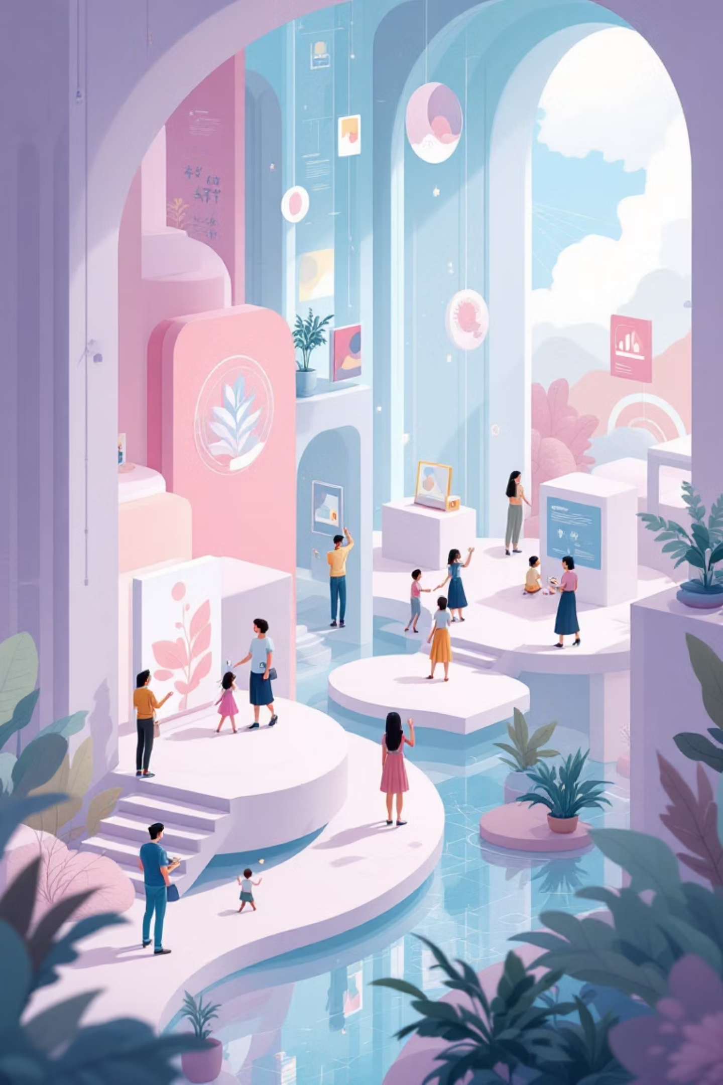



Planned Future Features
Our roadmap includes several key features designed to enhance usability and provide richer content management capabilities.
UI Retouches
Improve the current UI to make it more visually appealing for users and admin alike.
Multimedia Playback Support
Anticipate future content needs by building in functionality for audio file playback, should the Library decide to upload associated multimedia commentary or interviews.
Admin Security
Implement a secure login for FGCU staff, potentially adding Duo Push authentication if our project is chosen by the library.

